Slide 1



Modularity In Design for Microwave Spectroscopy Equipment
Arizona Space Grant Consortium Symposium
Garrett Veasey, UA/NASA Space Grant
Mentor: Dr. Adam Daly
Friday, April 21, 2017
Arizona State University, Tempe, AZ

Slide 2
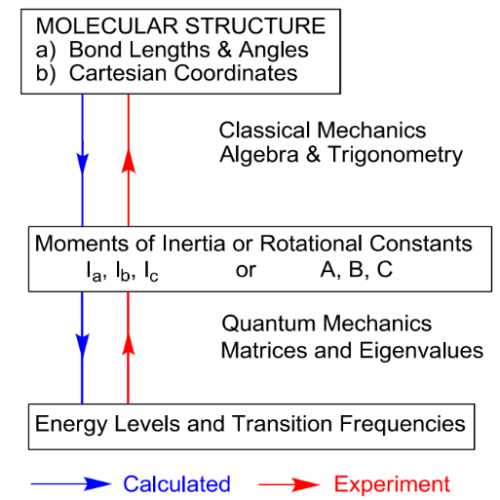
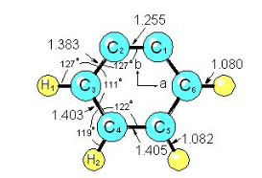
Microwave Spectroscopy
The study of the interaction between microwaves and matter.
This interaction can be detected by observing the attenuation of a microwave field as it passes through matter.
The absorption of microwaves by matter in the gas phase is represented as spectral lines.
Spectral lines tell us how many different energy levels an atom has, and how far apart those energy levels are spaced.
Provides detailed and accurate 3-D structures for many small molecules.

Slide 3
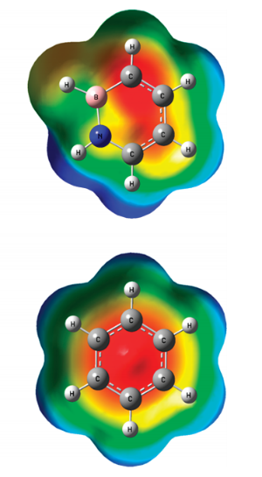
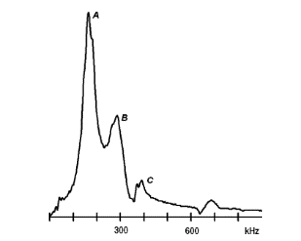
Applications
We know what molecules are in space based on rotational spectroscopy.
The emission or absorption spectrum of a substance is as unique to that substance as a fingerprint is to a human being.
Focus on transition metal complexes that play an important roles in the chemical industry and in biological systems.
Millions of tons of chemical products are produced each year using reactions with transition metal catalysts.
The University of Arizona is responsible for most of the published microwave structures of transition metal complexes.
Spectrometer data shows the emission of radiation, as a function of frequency or wavelength.

Slide 4
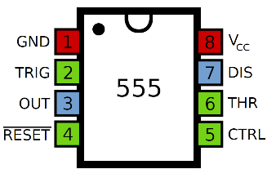
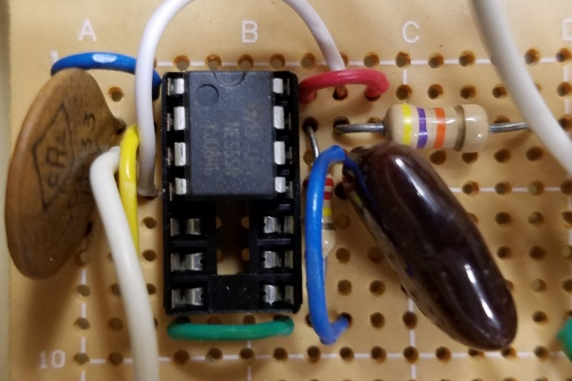
Microwave Spectrometer Development
The Kukolich lab uses 3 operating spectrometers that interface to computers for data collection and analysis.
The current microwave circuits utilize 555 timer IC logic.
The 555 timer is an integrated circuit chip used for timing and pulse generation applications.
The 555 timer circuits provide the necessary operations for data collection.
Building and testing digital electronic circuits for the microwave spectrometers.
Develop, improve, and test computer programs for data collection and create a modular control system to replace the microwave circuitry.
Notes:
Microwave circuits
Integrated circuits designed for operation at frequencies of approximately 1 gigahertz (GHz) or more.

Slide 5
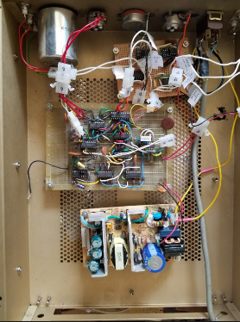
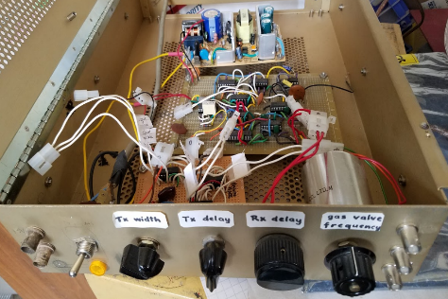
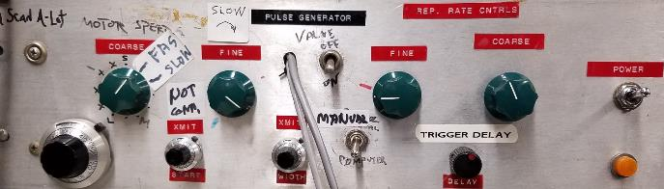
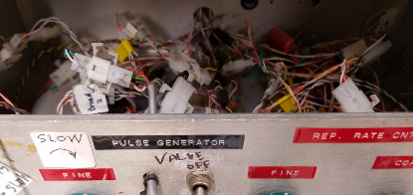
Microwave Circuits (Before)
Controls: pulse generator, motor movement, step frequency, digitize signal, open the valve and microwave switch, etc.
Difficult for troubleshooting.
It is tedious and time consuming to find the problem and fix it.
Non-flexible meaning the circuits are static and can only be used on the spectrometer it was built for.

Slide 6
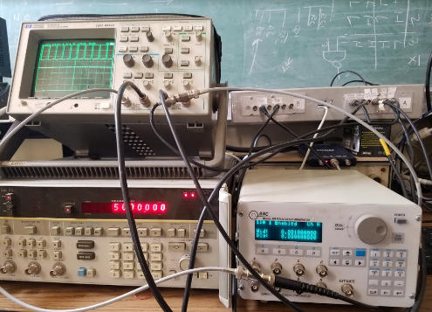
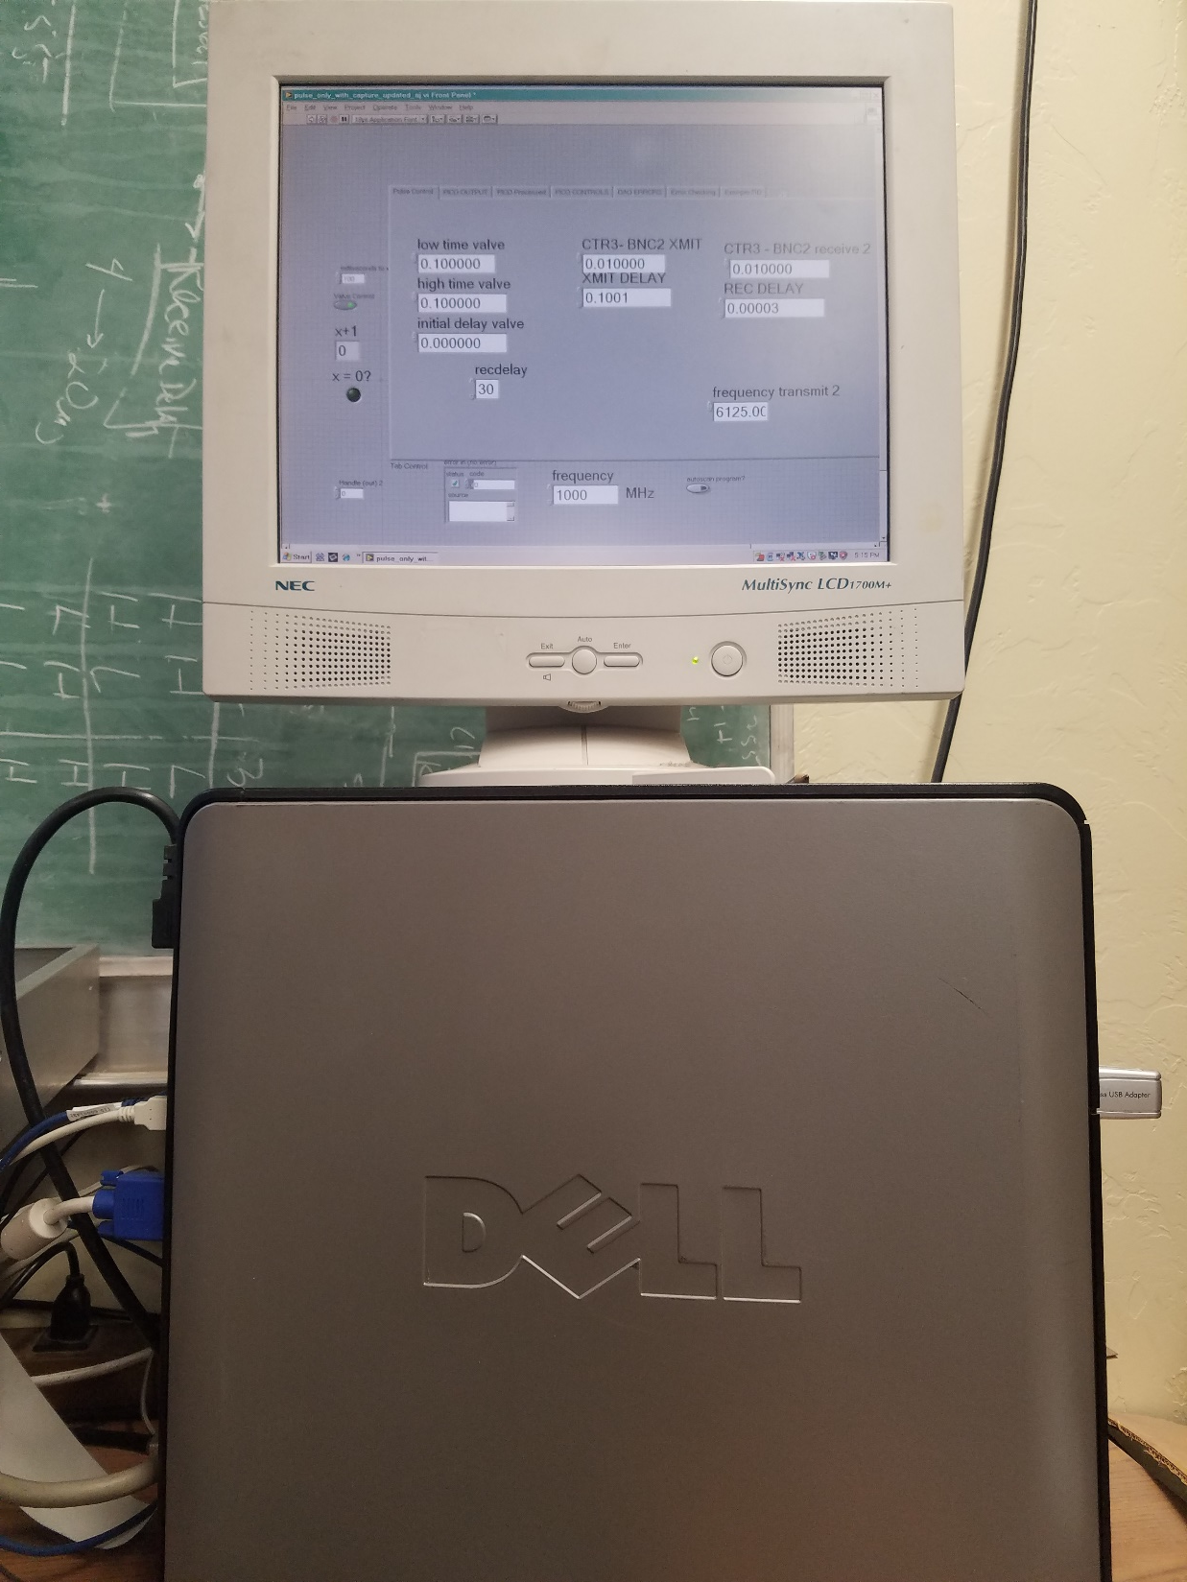
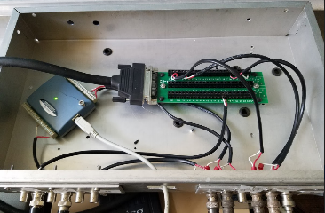
Modular Control System (After)
Utilized components found throughout the lab to implement the controls necessary for spectrometer operation.
The system contains the ability for adjustable controls for tuning.
The modular design approach subdivides a system into smaller parts that can be independently created and used in different systems.
With 3 operating spectrometers the system is designed for plug and play application across the different spectrometers.

Slide 7
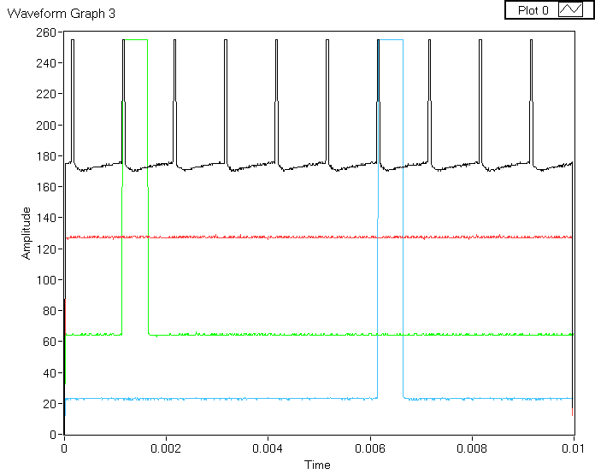
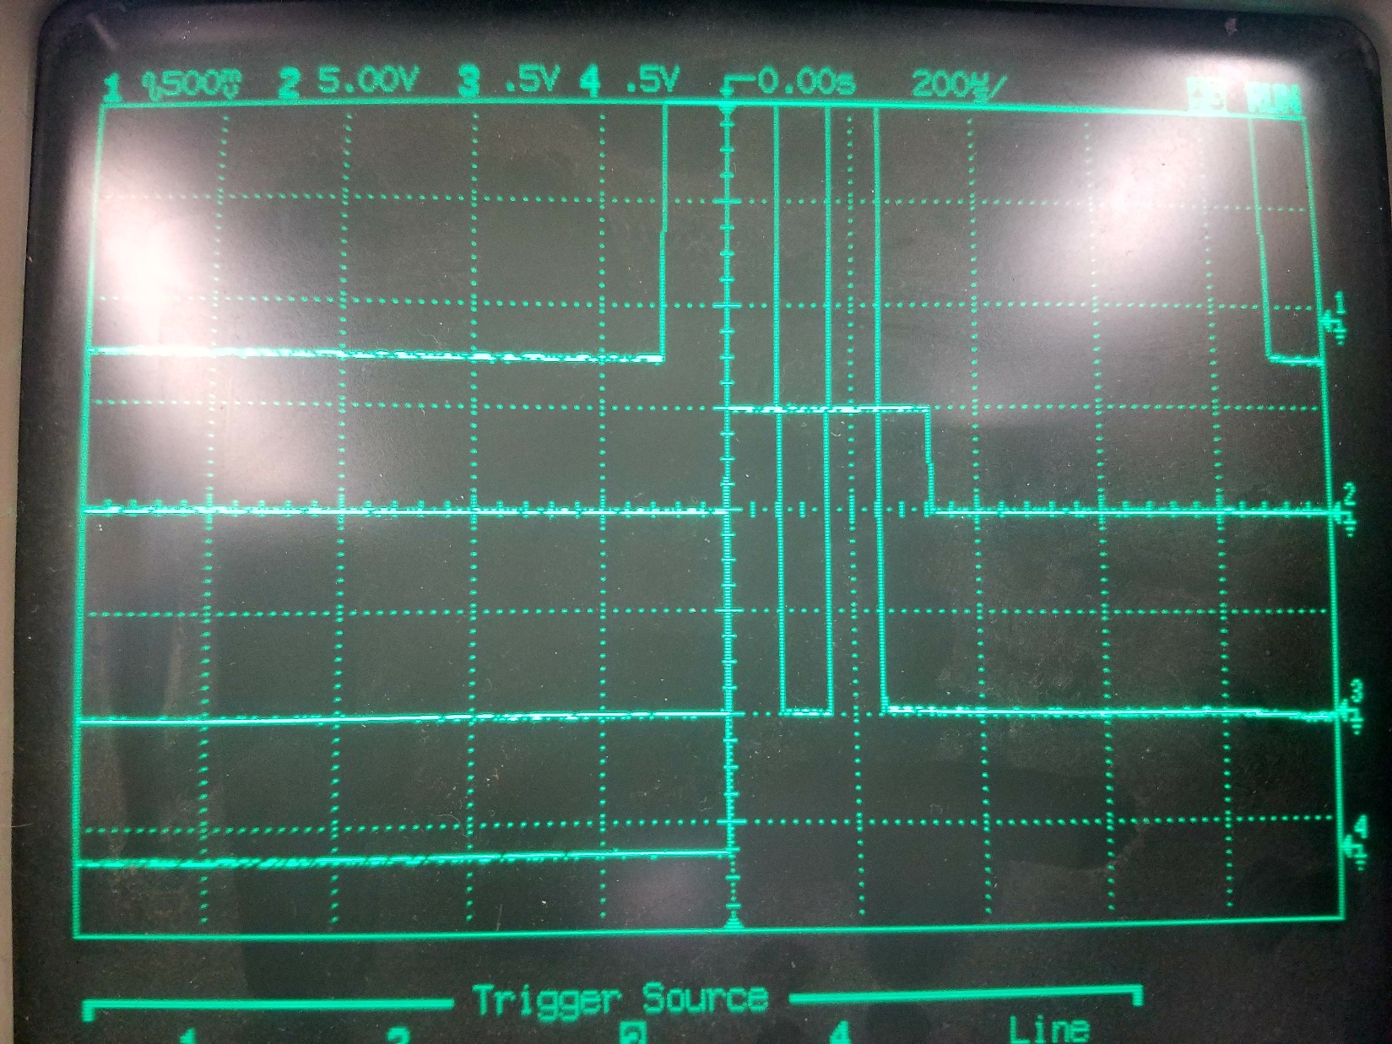
Results
LabVIEW graphical programming language used to communicate between the components for data collection and analysis.
The results show the precise timing necessary to trigger the necessary response from the spectroscopy equipment.
The current microwave circuitry is anticipated to fail at some point. When it does, there is solution ready for implementation.
Clock Signal
Open Microwave Switch
Open Valve
Transmit Signal

Slide 8
Conclusion
The modular design makes the system easy to troubleshoot and find a solution to a problem that may arise.
The data shows the precise timing of the instrumentation necessary for data collection and analysis.
Anticipating the circuits failure, there is a solution ready to replace and collect data immediately.
When any one subcomponent fails it can be replaced as fast as it can be ordered, if not already available.
The flexibility in design allows for adding new solutions by adding on to the existing system.

Slide 9
Acknowledgments
The Kukolich Lab Group
Dr. Steve Kukolich
Dr. Adam Daly
Aaron Pejlovas
Kexin Li

Slide 10
“Thank You”

